Slide 1
House Search
This presentation is for information purposes only, this is not legal advice. You should always contact a lawyer for legal questions. Greater Bakersfield Legal Assistance (GBLA) can be reached at (661) 325-5943.
Notes:
Hello my name is Manuela and I am a social worker in the Family stabilization program. We will be going over how to House search. House searching is an important factor in finding the right place for you and your family. This presentation is for information purposes only, this is not legal advice. You should always contact a lawyer for legal questions. Greater Bakersfield Legal Assistance (GBLA) can be reached at (661) 325-5943.

Slide 2
Tips for House Searching
z
Research creditable websites/leads
Beware of rental scams
Have a list of questions you would like to ask the landlord
Dress appropriate when meeting with potential landlords or realty managements
Is it livable? Know what to look for regarding health & safety
Stay Positive!
Notes:
House searching could become overwhelming so we have put together some beneficial tips to help during this process . 1. Make sure you are using creditable or trustworthy websites. 2.Beware of rental scams. 3. Have a list of questions you would like to ask the landlord. 4. Dress appropriate when meeting with the potential landlord 5. And ask yourself if the property is livable and what to look for when viewing the property. 6.Stay positive and don't give up.

Slide 3
Where to look for apartments
Make sure to look for creditable rental websites or leads.
Kern County Housing Authority:601 24th St, Bakersfield, Ca 93301 661.631.8500 https://kernha.org/menus/affordable-housing_1.htmlApartments.com
Five Star Property Management:2282 Ming Ave, Bakersfield, Ca 93304 661.831.3000 https://www.fivestarmgt.com/
TruStar Properties Management:4200 Easton Dr, Bakersfield, CA 93309 661.636.6163 https://www.trustar-properties.com
This Photo by Unknown author is licensed under CC BY-SA.
Notes:
Sometimes the hardest part is not knowing where to begin. When looking for housing leads make sure to use reliable websites. Here are just a few of the local property companies in Bakersfield and can be a starting point for your house searching. Due to Covid, hours might have been affected, please call ahead of time to verify their hours of operation and if they are allowing people in their office. When contacting private landlords or using sites such as Facebook marketing or craigslist be mindful of scams. Socializing and networking with people everywhere you go maybe another way to get potential housing leads. Mention to a friend or relative you are currently looking for an apartment, you never know if they know someone who is renting.

Slide 4
Distinctive Properties:4660 American Ave #102, Bakersfield, CA 93309 661.836.3311 www.distinctivepropertiespm.com D Best Realty: 405 S. Chester Ave, Bakersfield, Ca 93304 661.631.1111 https://www.dbestrealty.com/ Titan Real Estate Group Inc.:601 24th St. Ste.A Bakersfield, Ca 93301 661.863.0000 http://www.titanbakersfield.com/
Where to look for apartments Cont.

Slide 5
Avoiding Scams!
z
All though there are many scams to look out for, here is a list of the most common rental scams
Rental Scam #1-Copied Listings: Scammers often copy listing details from an actual listing and create their own positing for the apartment with a lowered price.
-How to avoid it: Make sure you’re able to view the apartment in person or through a virtual tour and refuse to pay any money before viewing it. It’s always best to stay away from situations where you’re asked to pay money without meeting the landlord or seeing the apartment first.
Rental Scam #2- Expensive Background Checks/Application fee: It’s common for landlords to complete a background check on all tenants to ensure you’re who you say you are. Typical fees are $30-60 and if you’re asked for more beware.
-How to avoid it: Never hand over cash on the spot without filling out an application. Try working with creditable property management or refer to your social worker if you have any doubts.
Notes:
Unfortunately rental scams are real and we must beware of them before signing a lease or making a payment. There are many types of rental scams out there but we have listed a few of them to review and ways you can protect yourself.
-Copied listings: If you've ever come across a listing that sound too good to be true, it probably is! Scammers will copy listing details from an actual listing and create their own posting for the property. They will take the details from this perfect apartment and lower the listing by a significant amount. They will build urgency and tell you they have a high volume of interest in the unit and in order to reserve It, you need to pay a deposit as soon as possible before someone else does. They might even refuse to virtually tour you through the unit without receiving the payment. In many instances they will mention they live out of state and need a deposit to give you the key. Make sure you're able to view the apartment in person inside and out or though a virtual tour and refuse to pay any amount of money before you do so. It's always best to stay away from situations where you're asked to pay upfront without meeting the landlord or viewing the property.
-Expensive Background checks or application fees: It's common for landlords to want to charge an application fee or background check fee so they ensure your identity. It typically runs any where from 30 to 60 dollars. If you're asked for more beware. Never give money on the spot without viewing the property and completing the application.
-No lease is a huge red flag! When you ask for the rental agreement, the landlord will make an excuse as to why they don't have one available. Verbal agreement is not very common and should make you question the landlord. Make sure you have inspected the property inside and out and have read the agreement over carefully before signing a contract. Ask any and all questions you may have prior to signing. Don't give any amount of money unless you have signed an agreement.
Never wire any amount of money or give out sensitive information such as : social security number or bank account number to someone you're unsure of. If something doesn't feel right, trust your instincts. It's better to be safe than sorry when it comes to your money. Remember if you have any doubts or concerns you can discuss it with your social worker. Social workers have access to verify the owner of a property.

Slide 6
Avoiding Scams cont.!
Rental Scam #3-No lease: Verbal agreement is not very common and should cause suspicion. An agreement without a lease has the potential to be a rental fraud.
-How to avoid it: Do not rent or pay without seeing a lease or rental agreement. Make sure you read the agreement over carefully and ask questions you may have.
Social Workers can always verify the ownership of the property or can contact the potential landlord if you have any doubts!
https://www.zumper.com/blog/most-common-rental-scams-and-how-to-avoid-them/

Slide 7
Examples of questions to ask landlord
Do you have any vacancies?
Monthly rent amount
Total deposit required
Screening criteria
Do you work with evictions?
Do you work with felonies/misdemeanors?
Notes:
Landlords should not be the only people screening potential tenants. You should be screening the apartment manager regarding the apartment complex to see if the area is a right fit for you and your family. Ask as many questions that come to mind before you submit an application and pay for a non-refundable application fee. Here are some examples of questions you might want to ask the landlord to determine if you would qualify for the property. After having your questions answered it should better help you determine whether or not you should apply for the property. After all you wouldn't want to waste your time or money if the landlord is not willing to work with your background.
Read the power point to list questions to ask.

Slide 8
Examples of questions to ask landlords cont.
Lease duration
What appliances are included (stove/Refrigerator, etc.)
Average utility cost
Maintenance repair policy
Payment method
Crime in neighborhood
When will the apartment be ready?
Notes:
What is the lease duration? Would you happen to know what the average utility cost is? Is there a maintenance repair policy? Do you have a payment method you prefer? Is there crime in this neighborhood?

Slide 9
Smart casual attire
.
First impressions are everything! Make sure to look presentable when apartment hunting.
-Combed hair
-Neat and ironed clothes
-Clean and trimmed nails
-Denims( typically a darker wash and no tears) or dress pants
-Dressy shirt or top, can add a blazer
-Light perfume/cologne
-Mid to low heels shoes for women and clean
minimalist style shoes for men.
Notes:
How you present yourself, is how people view you! Hygiene and appropriate attire are extremely important and can create a good or bad impression for prospect landlords. Dress for success! First impressions matter and we only get one opportunity. Always looks presentable and you will also feel confident. Smart casual attire is the look we strive for. Some of the things we listed to be mindful of were ...have Combed hair ,neat and ironed clothes, clean and trimmed nails, denims(no tears) or dressy pants, dressy shirt or top, blazer, light perfume/cologne. T-shirts are fine, Try to avoid any t-shirts with offensive words, terms or phrases. Women can wear mid to low shoes and clean and simple style shoes for men.
Simple exercise: Close your eyes and picture – you are waking up in the morning with no plans so you decide to stay in your pajamas, put your hair up in a ponytail, and sit on the couch and watch Netflix, get on social media, eat, and go on about your day. Keep your eyes closed - Now change how you begin your day – its morning and you are waking up change out of your pajamas, comb your hair, brush your teeth, simply look presentable (jeans and t-shirt) is fine. Have clients list two – three emotions describing how they felt for each exercise. By simply getting up and making an effort to look presentable you will find that your confidence will increase and will pretty, focused and ready to take on any challenge.
Clothing vouchers could be given to those who need them, simply ask your social worker.

Slide 10
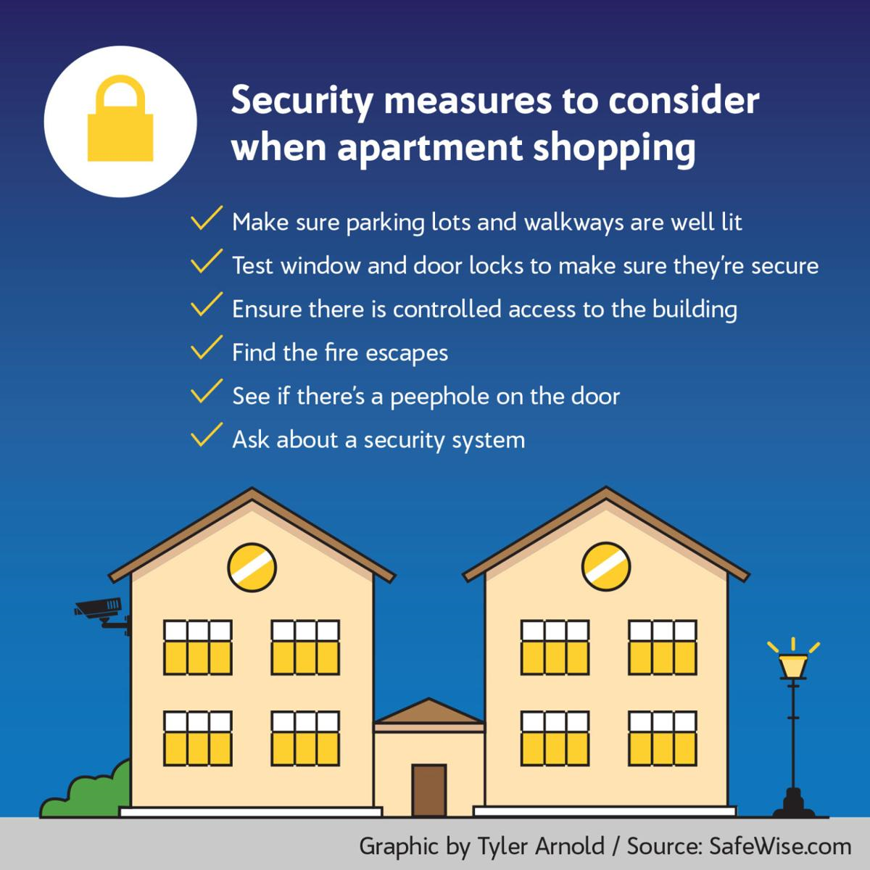
What to look for when viewing an apartment
Weather Protection: Roof and walls in tack, broken windows or doors
Plumbing and Gas: Make sure you have ability to hot and cold running water through pipes and sewage disposal system
Heating: Make sure heating unit is working properly
Electricity: Assure wiring and equipment is in good condition and no visible wires
Notes:
In the state of California it is mandatory that landlords keep rental properties livable. Landlords are required to maintain rental properties by taking care of all repairs. Landlords cannot bill tenants for any repairs to keep the property livable, unless the tenant is responsible for damages.
Remind clients that ---- It is also their responsibility to take care of the property they live-in – it’s their home – take care of it
Examples of livable properties:
Weather Protection - sealed roof and walls and unbroken windows and doors
Plumbing and Gas – hot/cold running water through pipes and sewage disposal system
Heating – heating facilities in working conditions
Electricity – wiring and equipment in good working condition and no live wires
Clean and Sanitary Premises – no rats, mice, cockroaches, and or any other insects
Working Toilet, tub, or shower
Operable dead Bolts – on main entry door
Fire Exits – working smoke carbon monoxide detectors and clean stairs, hallways and exits
Make sure to view the apartment from the outside during the day and night to make sure you feel safe in that area.
Livability will also be discussed more in detailed in our " Once you are moved" presentation.

Slide 11
What to look for when viewing an apartment cont.
Clean and Sanitary Premises: No rats, mice, cockroaches, and or any insects
Working toilet, tub, and shower
Operable dead Bolts: Able to open and close dead bolt on front door
Fire Exits: working smoke carbon monoxide detectors and clean stairs, hallways and exits
Make sure to view the apartment from the outside during the day and night to see if this an area you would feel safe living in.

Slide 12
Stay Positive!
z
Notes:
House searching can be overwhelming, use the tools learned in this series to better prepare yourself. Make sure you take it day by day and be patient. All you need is one YES and staying positive will help you through this process. Remember your social worker is also here to help you along the way. This presentation is for information purposes only, this is not legal advice. You should always contact a lawyer for legal questions. Greater Bakersfield Legal Assistance (GBLA) can be reached at (661) 325-5943.

